Slide 1
Polynomial representation using SLL: addition, multiplication and simplification

Slide 2
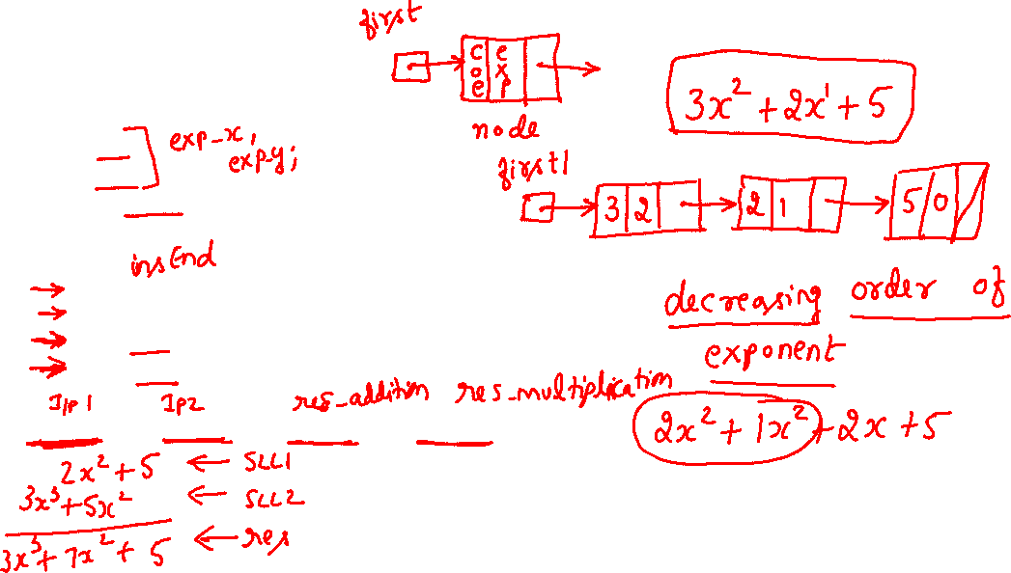
Polynomial representation using SLL 1/6
#include<iostream.h>
#include<conio.h>
class node
{
int exp;
int coe;
node *next;
public:
node *create(node *,int,int);
void display(node *);
node *add(node *,node *);
node *mul(node *,node *);
};
node *first1=NULL,*first2=NULL,*first3=NULL,*first4=NULL;

Slide 3
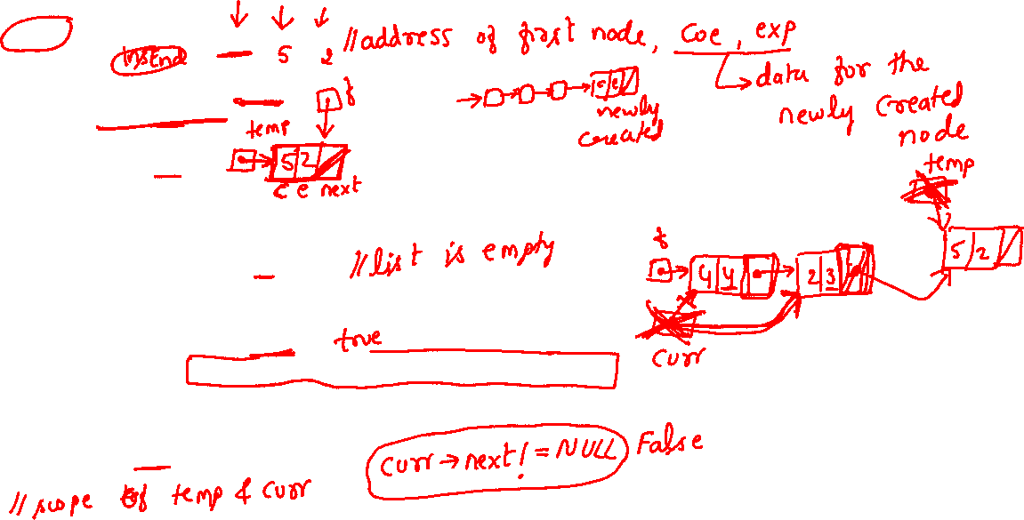
Polynomial representation using SLL 2/6
node * node::create(node *f,int c,int e)
{
node *temp;
temp=new node;
temp->coe=c;
temp->exp=e;
temp->next=NULL;
if(f==NULL) f=temp;
else
{
node *curr;
for(curr=f;curr->next!=NULL;curr=curr->next);
curr->next=temp;
}
return(f);
}

Slide 4
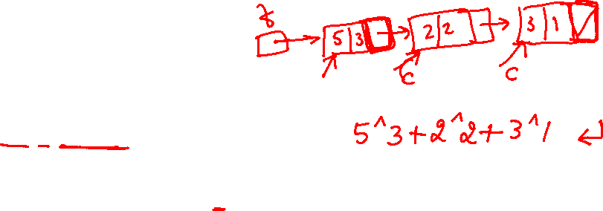
Polynomial representation using SLL 3/6
void node::display(node *f)
{
for(node *curr=f;curr!=NULL;curr=curr->next)
{
cout<<curr->coe<<"^"<<curr->exp;
if(curr->next!=NULL&&curr->data>0)
cout<<"+";
}
cout<<"\n";
}

Slide 5
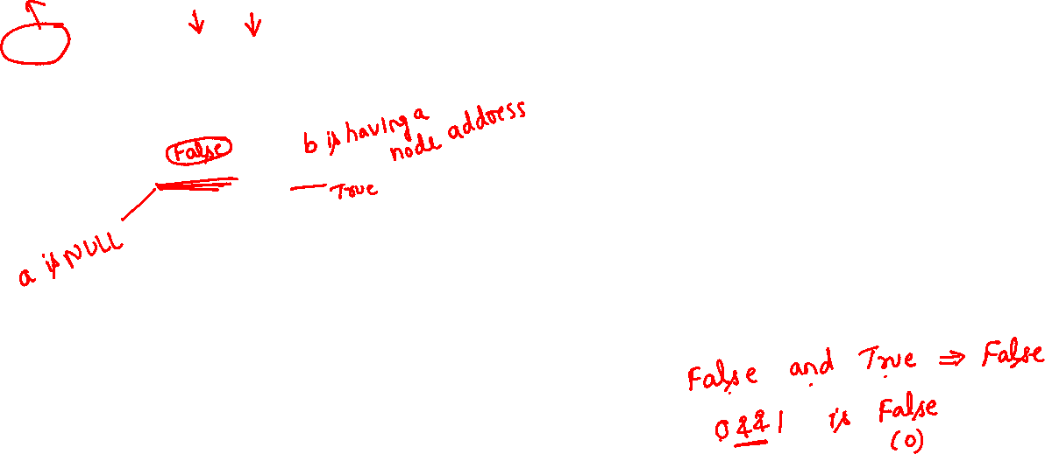
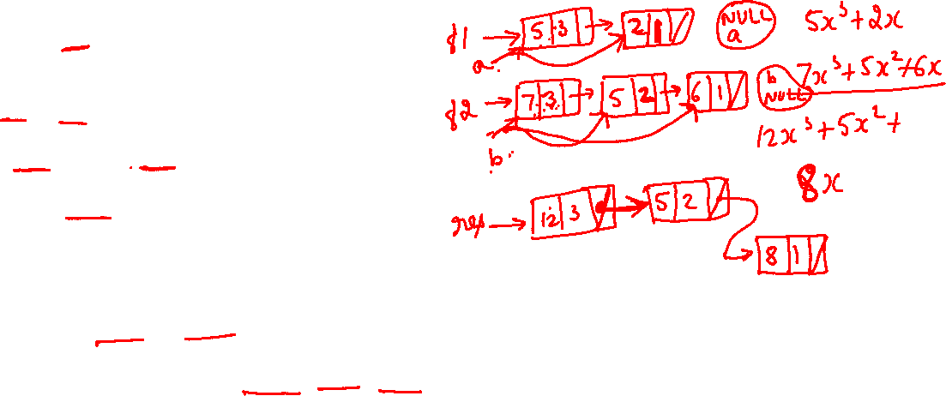
Polynomial representation using SLL 4/6
node* node::add(node *f1,node *f2)
{
node *res=NULL;
node *a=f1,*b=f2;
while((a!=NULL)&&(b!=NULL))
{
if (a->exp>b->exp)
{
res=create(res,a->coe,a->exp);
a=a->next;
}
else if(a->exp==b->exp)
{
res=create(res,a->coe+b->coe,a->exp);
a=a->next;
b=b->next;
}

Slide 6
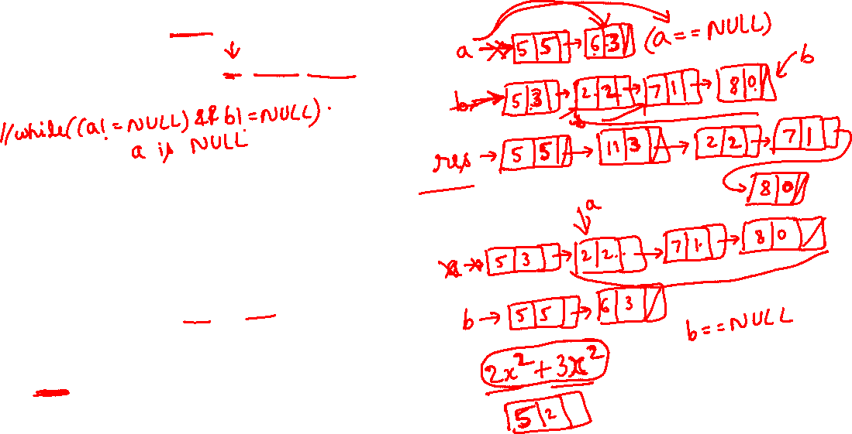
Polynomial representation using SLL 5/6
else //b->exp>a->exp
{
res=create(res,b->coe,b->exp);
b=b->next;
}
}
while(a!=NULL)
{
res=create(res,a->coe,a->exp);
a=a->next;
}
while(b!=NULL)
{
res=create(res,b->coe,b->exp);
b=b->next;
}
return(res);
}

Slide 7
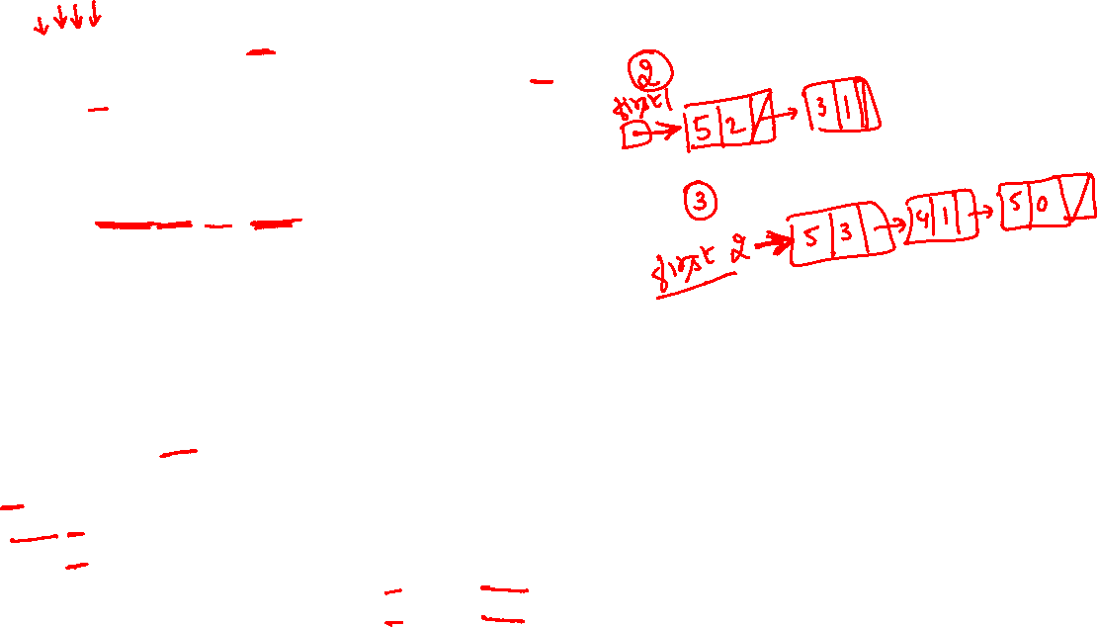
int main()
{
int n,i,e,c; node a;
cout<<"how many terms in 1 polynomial\n"; cin>>n;
for(i=0;i<n;i++)
{
cout<<"\nEnter coe: "; cin>>c;
cout<<"Enter exp: "; cin>>e;
first1=a.create(first1,c,e);
}
a.display(first1);
cout<<"how many terms in 2 polynomial\n"; cin>>n;
for(i=0;i<n;i++)
{
cout<<"\nEnter coe: "; cin>>c;
cout<<"Enter exp: "; cin>>e;
first2=a.create(first2,c,e);
}
a.display(first2);
first3=a.add(first1,first2);
first4=a.mul(first1,first2);
cout<<"Result of addition: "; a.display(first3); cout<<endl;
cout<<"Result of multiplication: "; a.display(first4); cout<<endl;
}
Polynomial representation using SLL 6/6

Slide 8
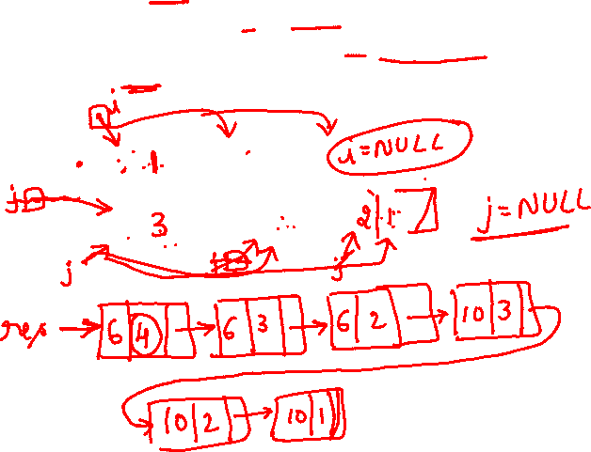
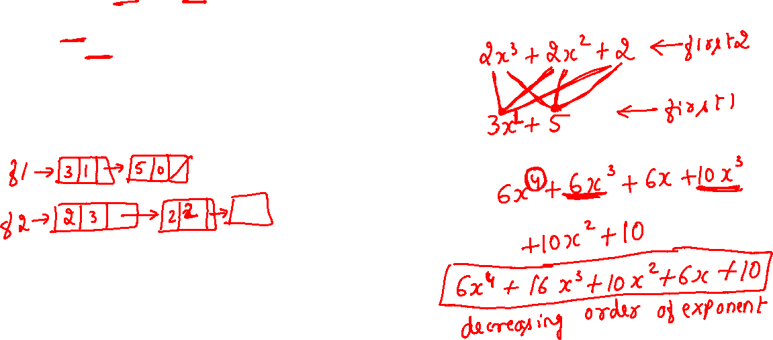
node * node::mul(node *f1,node *f2)
{
node *res=NULL;
for(node *i=f1;i!=NULL;i=i->next)
for(node *j=f2;j!=NULL;j=j->next)
res=create(res,i->coe*j->coe,i->exp+j->exp);
return(res);
}

Slide 9
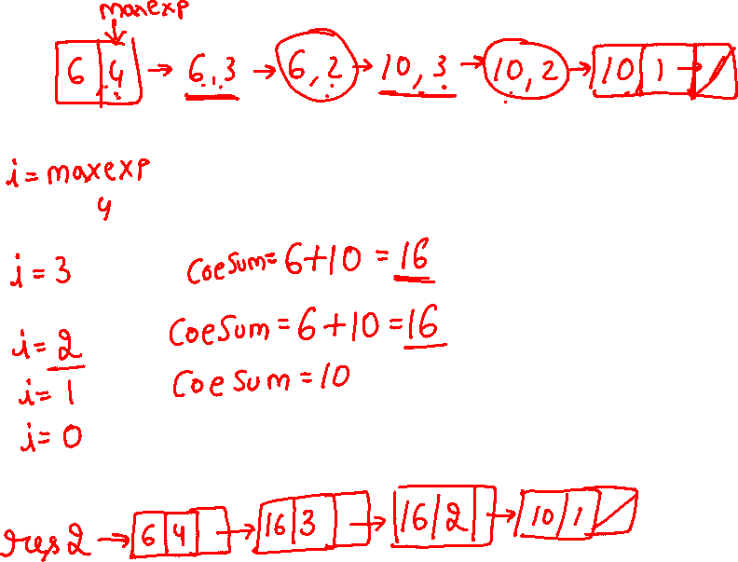

Slide 10

// Simplification after multiplication
node * node::mul(node *f1,node *f2)
{
node *res=NULL;
for(node *i=f1;i!=f1;i=i->next)
for(node *j=f2;j!=f2;j=j->next)
res=create(res,i->coe*j->coe,i->exp+j->exp);
res=simplify(res);
return(res);
}
node *simplify(node *r)
{
if(!r) return(NULL);
node *c,res2=NULL;
int i,coeSum=0,maxExp=r->exp;
for(i=maxExp;i>=0;i--){
coeSum=0;
for(c=r;c;c->next) if(c->exp==i) coeSum=coeSum+c->coe;
res2= create(res2,i,coeSum);
}//for
return(res2);
}

Slide 11
